Slide 1
Graffiti
AS AN ART FORM

Slide 2
What is Graffiti?
Graffiti art originated in stone age , and it has been developing ever since.
Graffiti is writing or drawings that have been scribbled, scratched, sprayed or painted illicitly (illegally) on a wall or other surface in a public place.

Slide 3
HISTORY
The origins of graffiti go back to the beginnings of human and community living.
Graffiti has also been found on uncovered, ancient, Egyptian monuments, and graffiti even was preserved on walls in Pompeii (Rome).

Slide 4
Graffiti is the plural form of the Italian word grafficar. Which signifies drawings, markings, patterns, scribbles, or messages that are painted, written, or carved on a wall or surface.

Slide 5
Grafficar also signifies "to scratch" in reference to different wall writings ranging from "cave paintings", bathroom scribbles, or any message that is scratched on walls.

Slide 6
ANCIENT GRAFFITI

Slide 7
Crusader Graffiti in the Church of the holy sepulcher Jerusalem Victor

Slide 8
Graffiti politique de Pompei

Slide 9
Bathroom Scribbles

Slide 10
MATERIAL
In modern times, paint, particularly spray paint, and marker pens have become the most commonly used graffiti materials.
Enamels, oil paints, spray paints and stencils are also used for Graffiti Art.

Slide 11
In ancient times graffiti was carved on walls with a sharp object, although sometimes chalk or coal were used.
In most countries, marking or painting property without the property owner's consent is considered defacement and destruction, which is a punishable crime.

Slide 12
SUBJECT MATTER
Graffiti also may express underlying social, political and awareness campaigns.

Slide 13
Within hip hop culture (African American art movement towards the end of 20th contury), graffiti has evolved alongside hip hop music, and other elements.
Unrelated to hip-hop graffiti, gangs use their own form of graffiti to mark territory or to serve as an indicator of gang-related activities.

Slide 14
Graffiti

Slide 15
WESTERN GRAFFITI
Anonymous English artist Banksy

Slide 20
Lime- light Graffiti street

Slide 23
Graffiti as a memorial
People often leave their traces on trees, wet cement or concrete.
This type of graffiti often commemorates the mutual commitment of a couple, or simply records a person's presence at a particular moment.

Slide 25
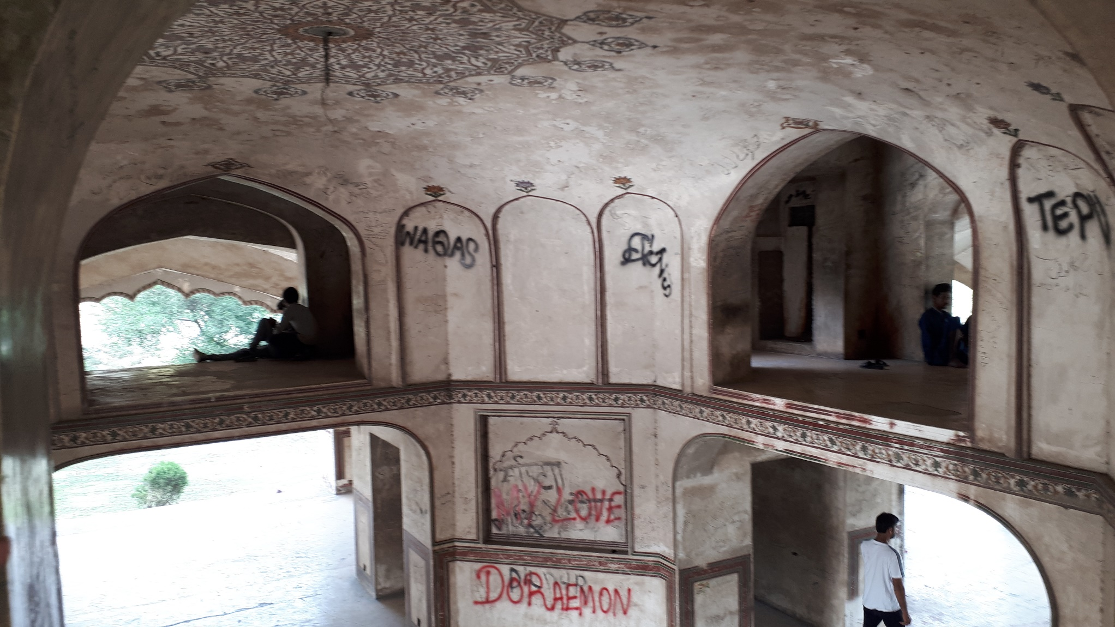

Slide 26
Environmental Effects
Spray paint has many negative environmental effects.
The spray paint contains toxic chemicals, and produce chloroform carbons or impulsive hydrocarbon gases which are not good for respiratory system and asthmatic patients.
Spray paints are aerosols which are responsible for the damage of the ozone layer.

Slide 27
Scribbling on Rohtas Fort

Slide 31
Street art can be explained as forms of visual art created in public areas, usually forbidden art work (graffiti) performed outside of the background of traditional art venues. Street art earned popularity in the early 1980s and continues to expand in various techniques and categories in conveying the messages. Consequently, a difference in cultural practice has appeared in many cities since the late 1990s; street art also includes the placement of unassigned artwork in public places.
Different people perceived it differently, some people see it as a form of graffiti while some perceived as a new art movement; although, it is professional engagement in unlawful activities. Furthermore, street art possesses a very old history; going all the way to the ancient inscriptions. It has become a popular issue, since most people do not know whether it is crime or art. Street artists have been blamed for vandalism, malevolence, damage, intention to ruin, of property, illegal intrude, and against the social principles.

Slide 32
In modern times, the use and application of street art have changed. Street art is a promotional tool used to challenge the meanings of the landscape elements that dominate current cities, foster social inclusion in the city, advertising industry, as well as creates the tourism industry for the city.
Likewise, it has changed to the furniture of our cities. Several of these works need a high-level of skills, techniques and a great concentration to the detailing. Moreover, some of the arts reflect simple images and phrases, which convey a deeper meaning, and sometimes their creation is spurred by the urge to create and just have fun.

Slide 33
Street Art

Slide 37
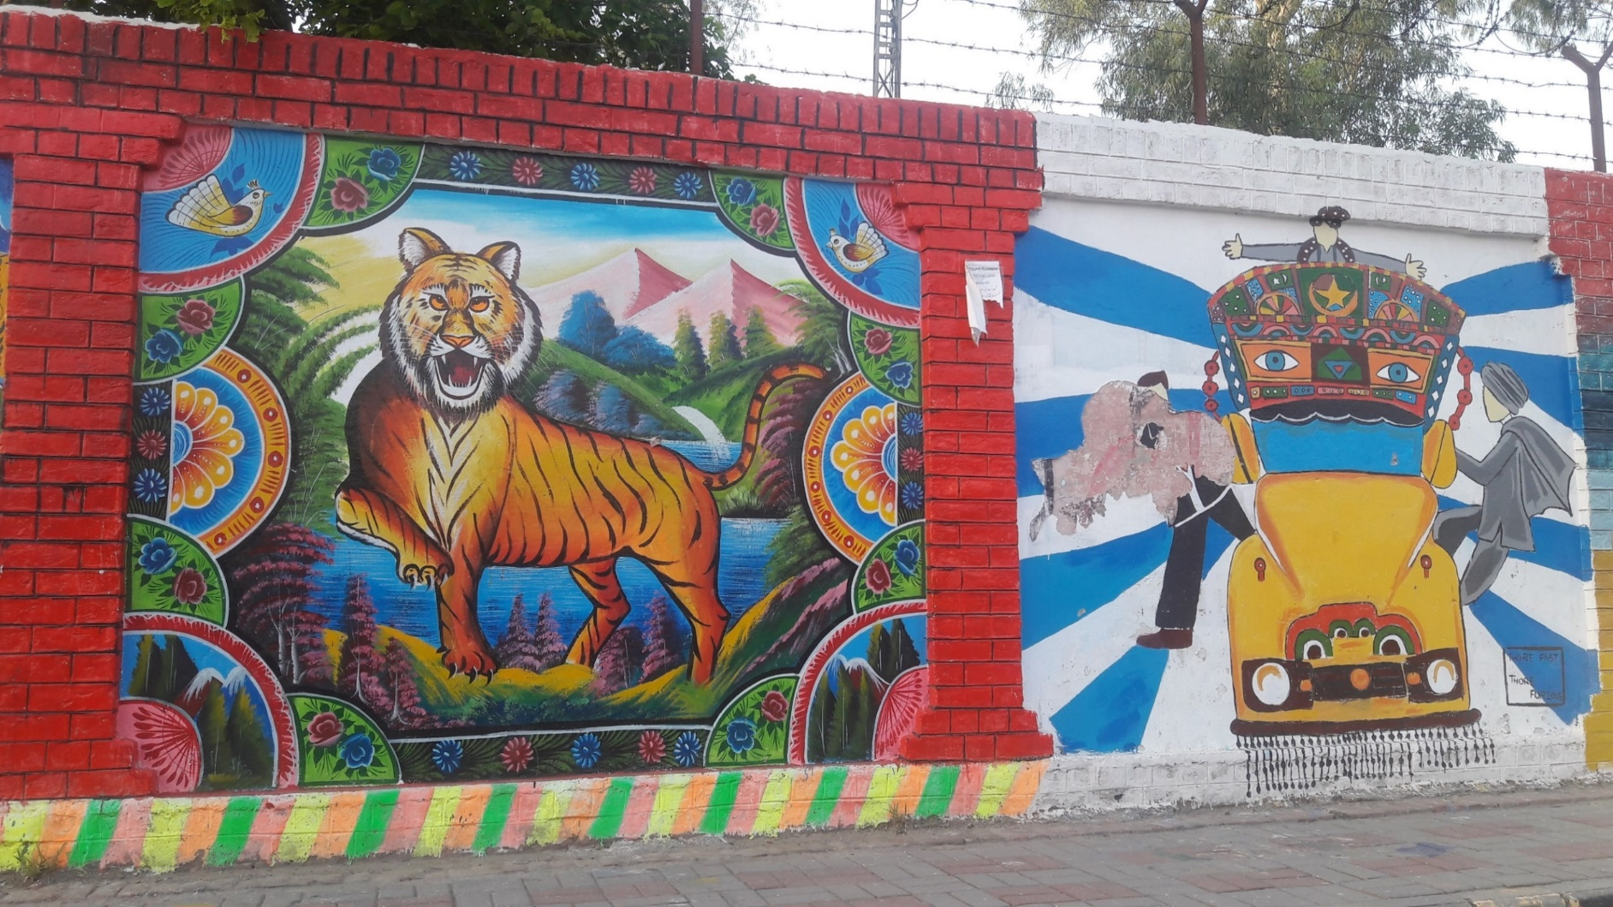
Truck Art Motifs, 2019, Wahdat Road, Lahore

Slide 38
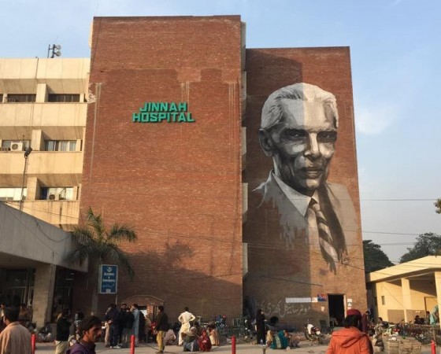
Portrait of Quaid-e-Azam, 2016, Jinnah Hospital, Lahore

Slide 39
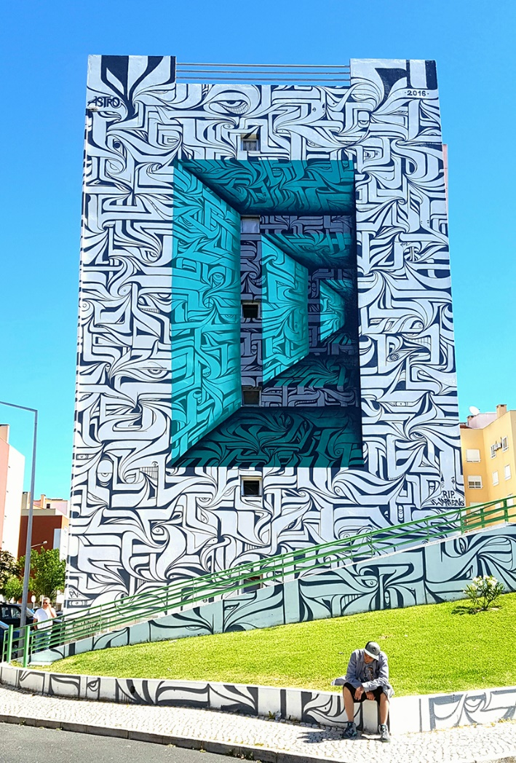
Lisbon, Portugal

Slide 40
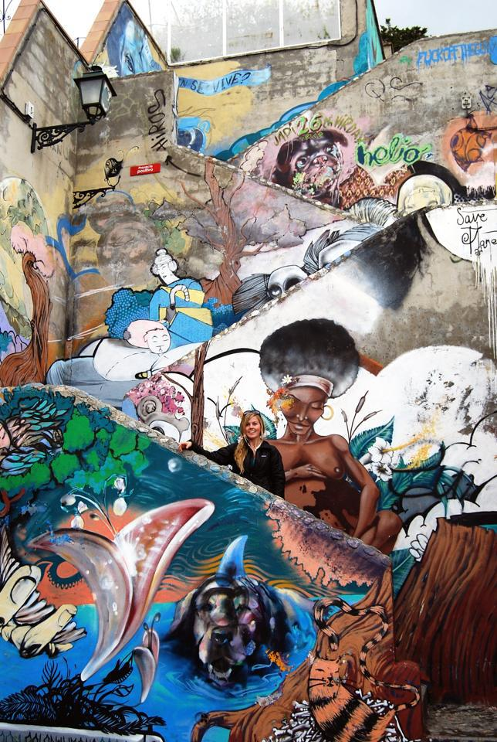
Granada, Spain

Slide 41
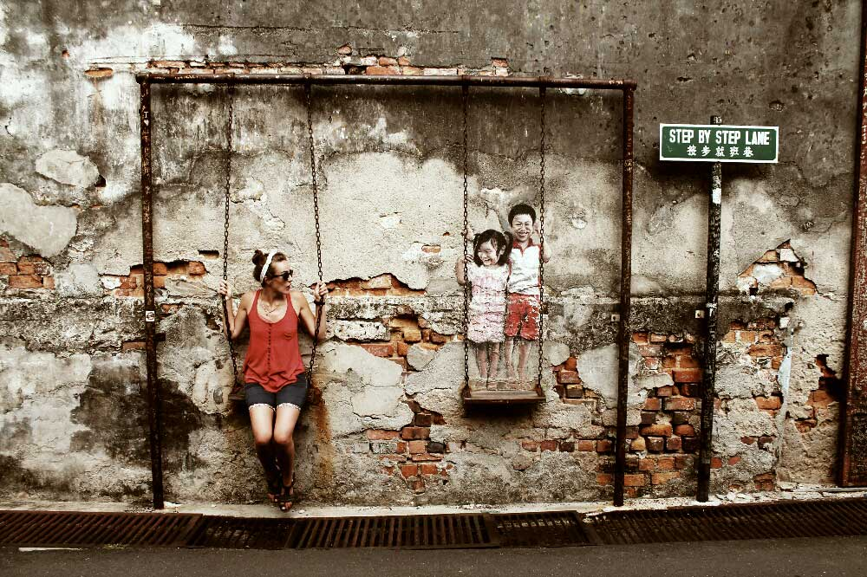
SOUTH EAST ASIAN STREET ART
Georgetown, Penang, Malaysia

Slide 42
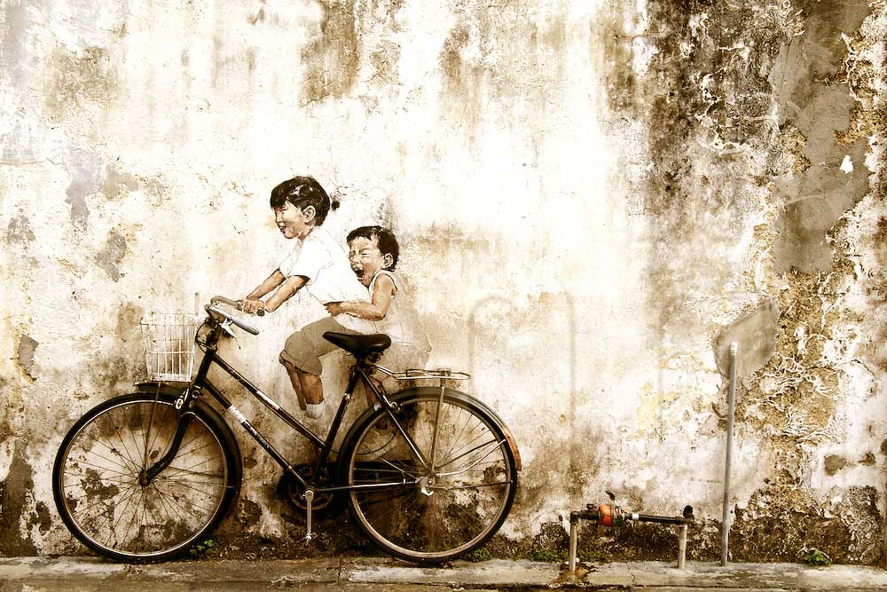
Georgetown, Penang, Malaysia

Slide 43
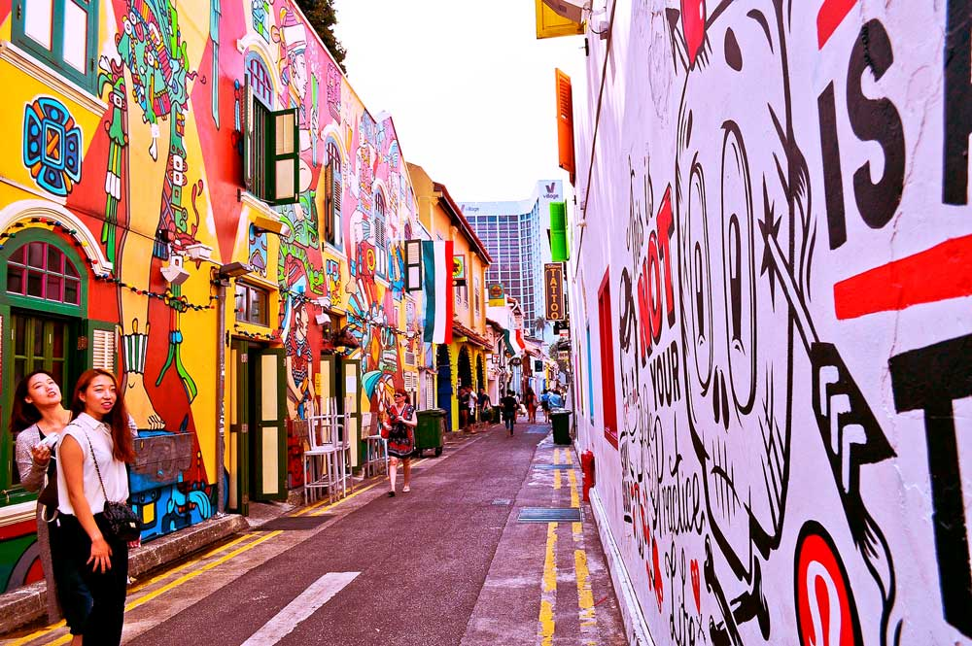
Kampong Glam, Singapore

Slide 44
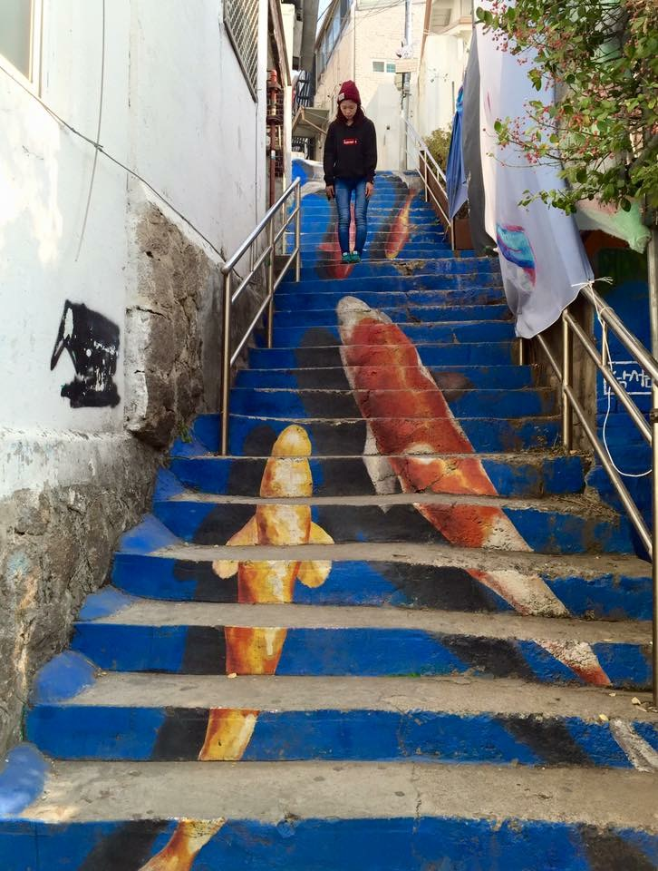
Ihwa Mural Village, South Korea

Slide 45
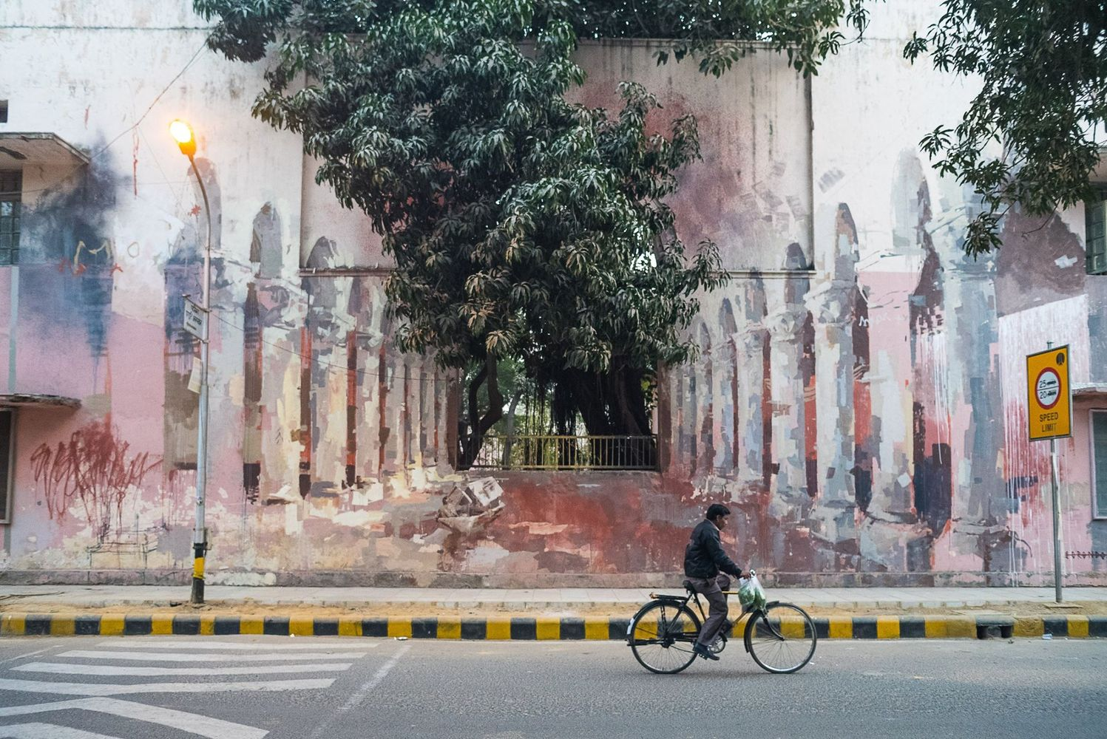
INDIAN STREET ART
The Origin of the World by Borondo, Lodhi Colony, Delhi, India

Slide 46
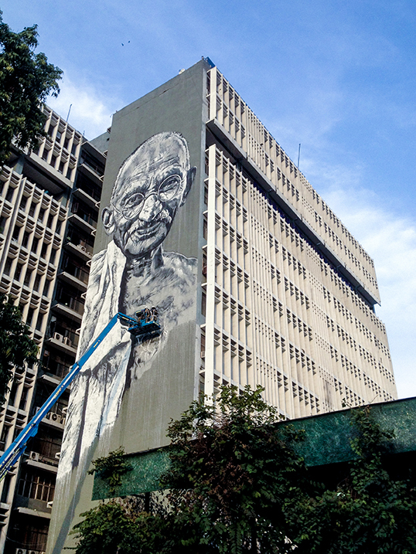
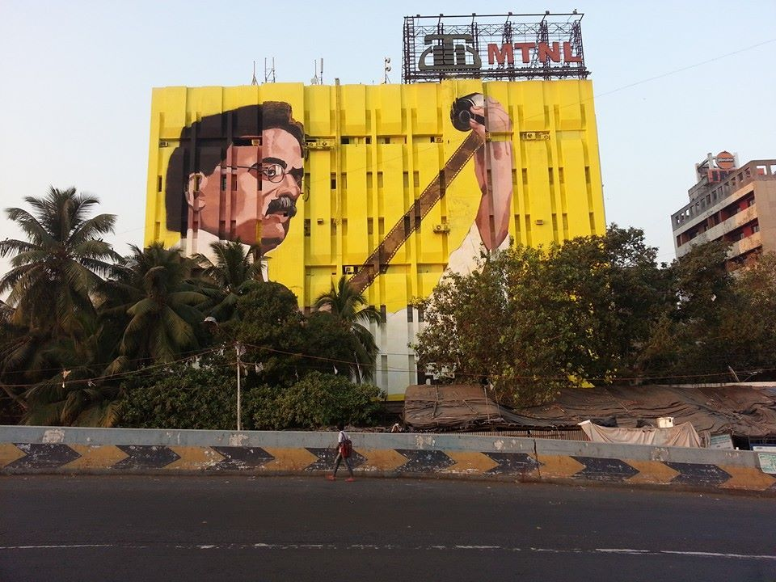
Gandhi Mural by Hendrik Beikirchand Anpu Varkey, Delhi, India
Dadasaheb Phalke by Ranjit Dhaiya MTNL Building, Mumbai, India

